Slide 1
Display Light Intensity using Node-Red and MQTT
Aim: Using appropriate nodes in Node Red measure the light intensity in the room and output data to the web API. Display the output in Debug Monitor, UI and send the data through MQTT and display the output in HiveMQ.
Theory:
MQTT (Message Queuing Telemetry Transport) is an open OASIS and ISO standard (ISO/IEC 20922) lightweight, publish-subscribe network protocol that transports messages between devices. The protocol usually runs over TCP/IP; however, any network protocol that provides ordered, lossless, b i-directional connections can support MQTT. It is designed for connections with remote locations where a "small code footprint" is required or the network bandwidth is limited.
MQTT is a publish-subscribe-based messaging protocol used in Internet of Things. The goal is to provide a protocol, which is bandwidth-efficient and uses little battery power.
Procedure:
Trigger node red in cmd using node-red -v
http://127.0.0.1:1880/
Arrange nodes according to the flow and assign properties
Open HiveMQ and get the output
http://www.hivemq.com/demos/websocket-client/

Slide 2
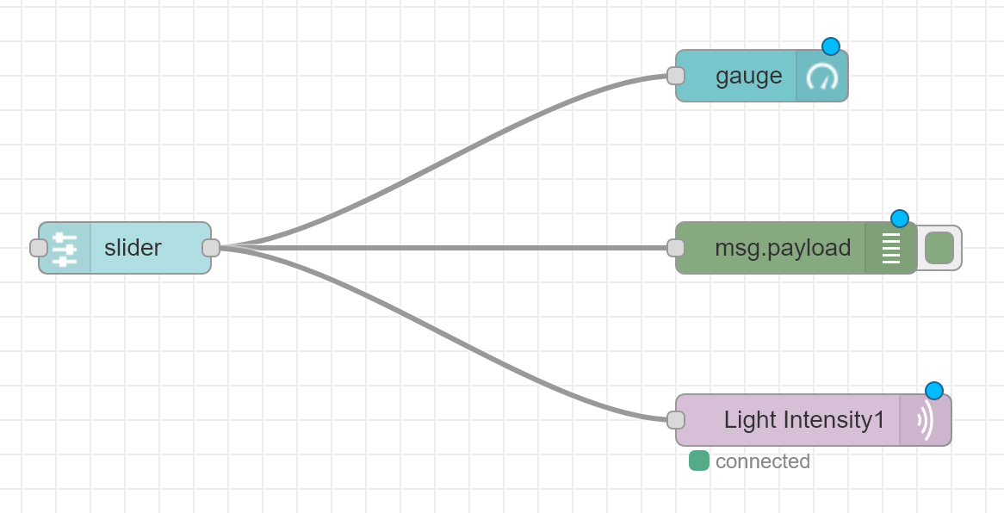

Slide 3
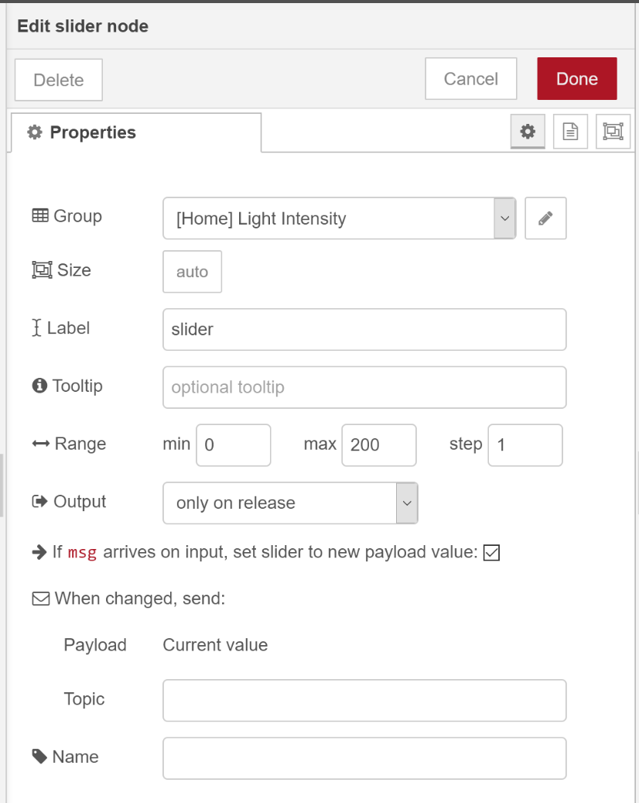
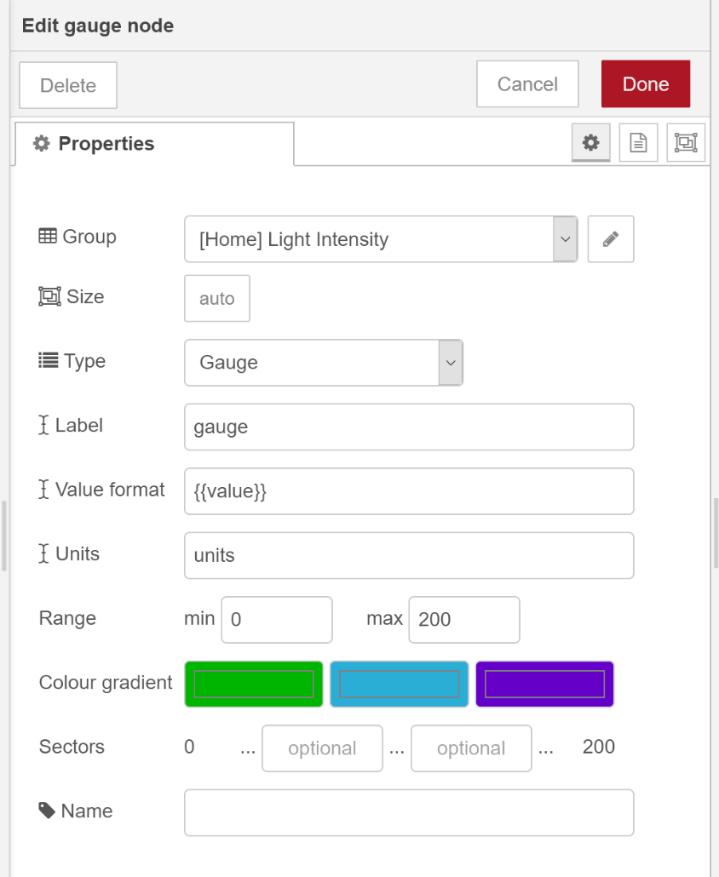
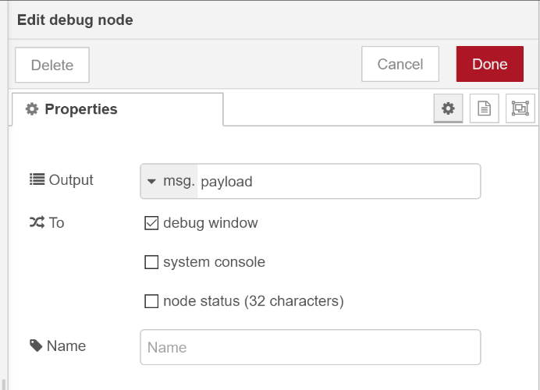
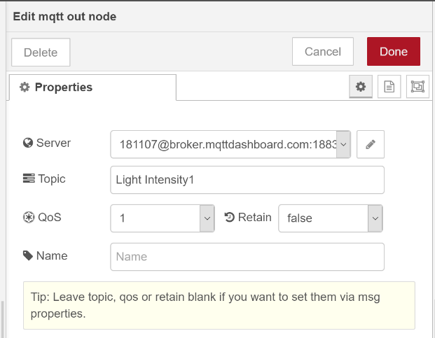

Slide 4
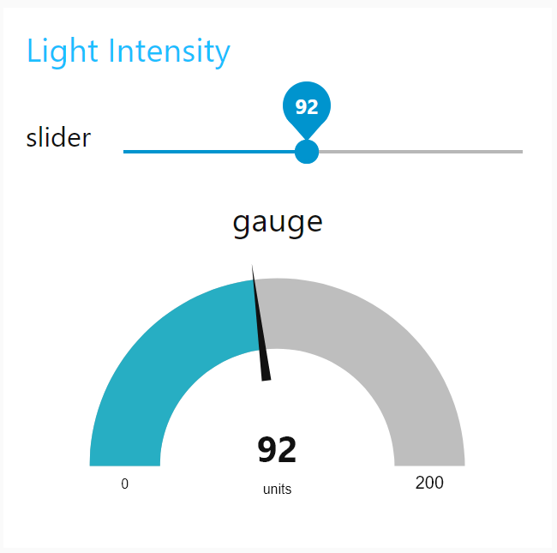
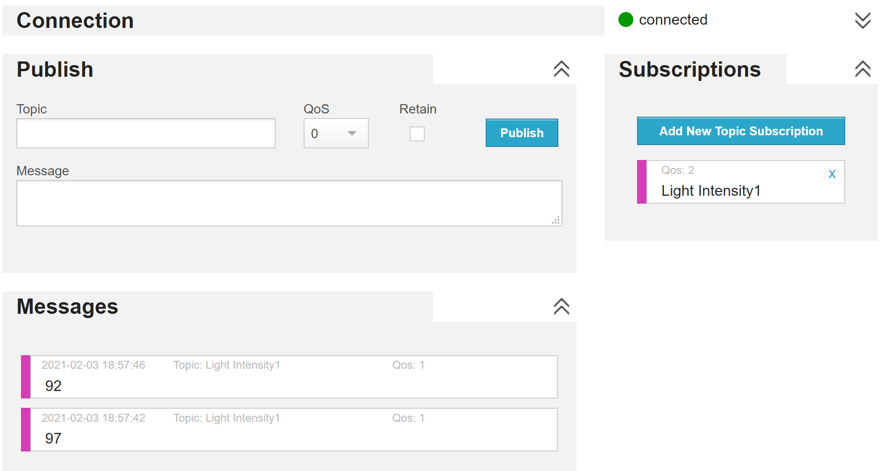
Output:
Dashboard:
MQTT:
Inference: A slider node is used to control the light intensity by the user. This is measured and published to the MQTT server using MQTT out node
Result: Hence, Light Intensity has been measured, displayed and published using MQTT and Dashboard

